Slide 1
BIM & Smart Construction Technologies for Tracking the Construction Process and Problem Identification at the Early Stages of Construction
Lee, Jin Gang
Sunmoon University

Slide 2
Lecturer
이진강 (Lee, Jin Gang)
jinganglee@sunmoon.ac.kr
Education
Bachelor, Seoul National University (2007 – 2011) Dept. of Architecture and Architecture Engineering
Master of Science, Seoul National University (2011 – 2013) Construction Engineering and Management Laboratory Thesis: BIM based Cost-Schedule Integration using IFC for Building Construction
Doctor of Philosophy, Seoul National University (2013 – 2019) Construction Engineering and Management Laboratory Thesis:Conceptual Estimation of Construction Cost by Neural Network Ensemble Learning incorporating Factor Analysis
Experiences
Assistant Professor, Sunmoon University, Division of Architecture (2021 ~ present)
Postdoctoral Fellow, The Hong Kong Polytechnic University, Dept. of Building and Real Estate (2019 ~ 2020)
Researcher, Seoul National University Institute of Construction and Environmental Engineering (2019)
Research Interest & Teaching Area
BIM Applications for Design Collaboration and Construction Management
Smart Construction Technologies: Virtual Reality, Augmented Reality, Machine Learning, Computer Vision
Construction Management: Schedule, Cost, Safety, Quality

Slide 3
Contents
Background
Building Information Modeling (BIM)
Definition
Problem Identification at the Early Stages of Construction
Smart Construction
Definition
Technologies for Tracking the Construction Process

Slide 4
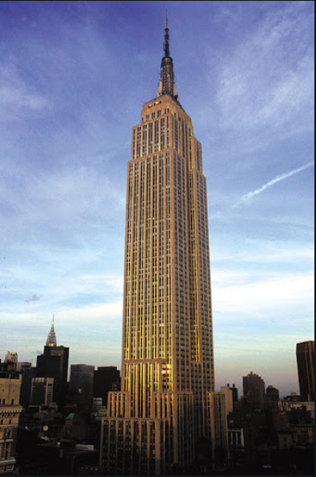

Background
Construction Productivity
Empire State Building (New York, 1930)
Lotte World Tower (Seoul, 2016)
vs

Slide 5
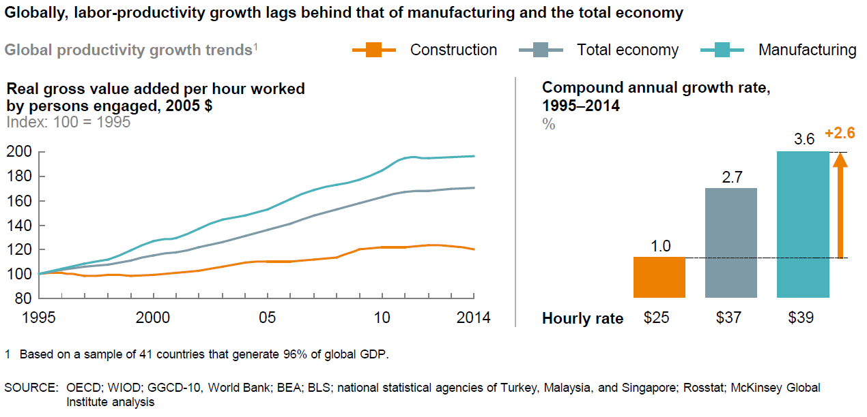
Background
Productivity of Construction Industry
The construction industry is known as a typical high cost and low productivity industry.
Reference: Mckensey (2017), Reinventing Construction

Slide 6
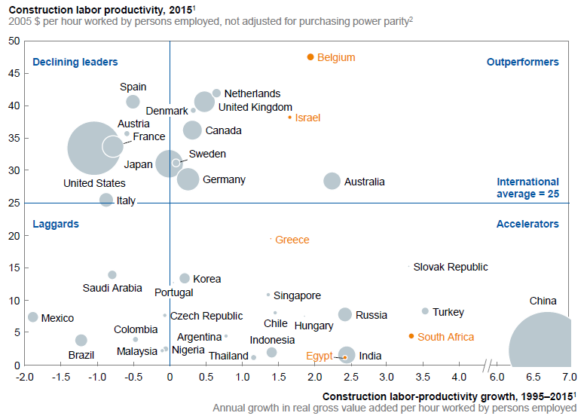
Background
Productivity of Construction Industry
The construction industry is known as a typical high cost and low productivity industry.
In the case of South Korea, it is growing every year, but it is only half of the global average.
Reference: Mckensey (2017), Reinventing Construction

Slide 7
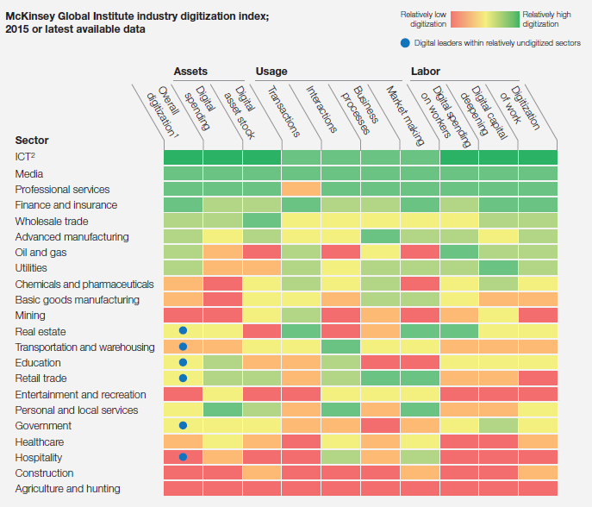
Background
Digitalization of Construction Industry
Contrary to the 4th industrial revolution, the level of digitization in the construction industry is low.
Construction industry requires digital transformation.
Reference: Mckensey (2016), Imagining Constructions Digital Future

Slide 8



Building Information Modeling
Project Management
Plan / Execute / Manage elements of resources in accordance with project goals to produce the final product of a construction project.
Project Information Management
Project information management is to efficiently collect, share, and process information necessary for project planning and management so that it can be used effectively and managed so that it can be used as data for future plans, etc.
Resources: Equipment, Labor, Material
Information: Drawing, Schedule, Cost, Law
Goals: Time, Cost, Quality, Safety
Image Source: https://www.saviom.com/index.php

Slide 9
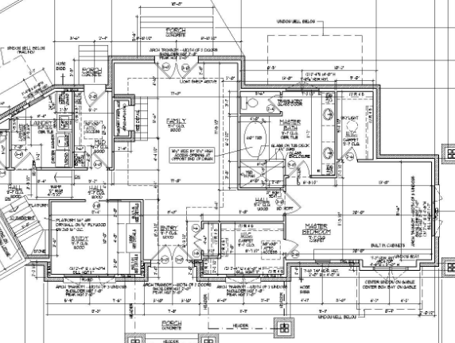
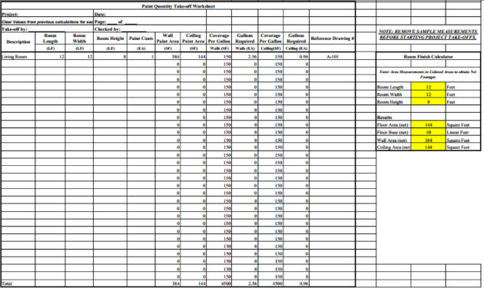
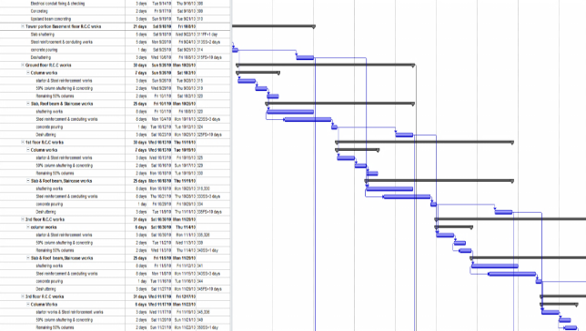
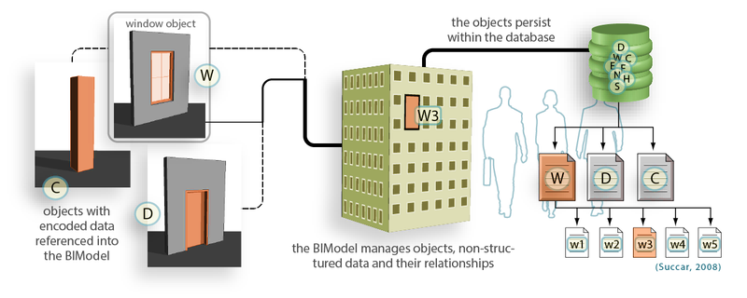
Building Information Modeling
Definition
BIM is the creation and management of information necessary for various decision-making of a construction project in a computer-interpretable form (digital) based on the object of the 3D model (object-oriented).
Cost
Integrated Management
Drawing
window
Project Information DB
law
cost
schedule
Schedule
column
door
Object-oriented Modeling
properties
Image Source: Succar, B. (2009); doi:10.1016/j.autcon.2008.10.003

Slide 10
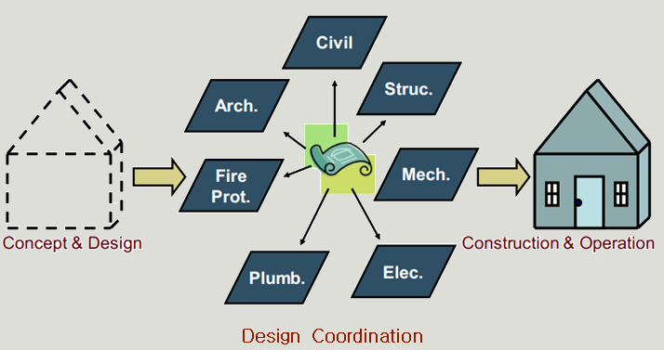
Building Information Modeling
Design Coordination / Collaboration
A collaborative process between various specialties such as architecture, structure, MEP, etc..
Design collaboration is the process of integrating design proposals from individual specialties.

Slide 11

Building Information Modeling
Design Coordination / Collaboration
There are hundreds or thousands of issues to be resolved in the design collaboration process, which consumes considerable time.
40-50% of total work hours
24 hours
per week
Some meetings often take 3 hours

Slide 12
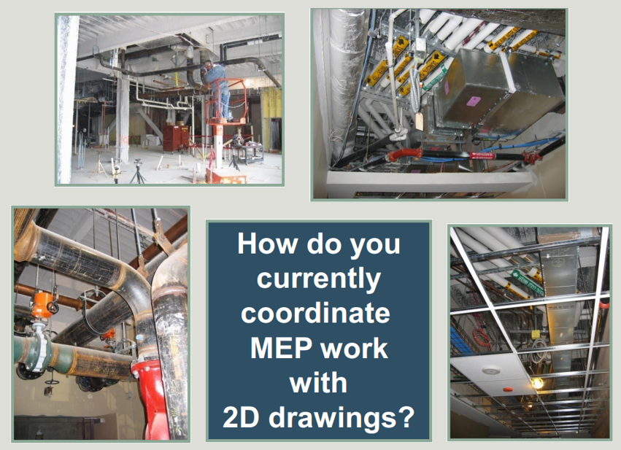
Building Information Modeling
3D Visualization
2D vs 3D

Slide 13
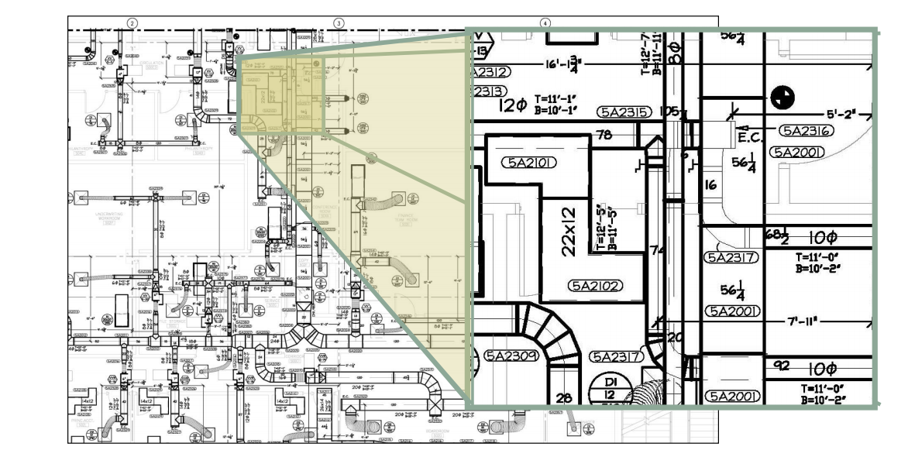
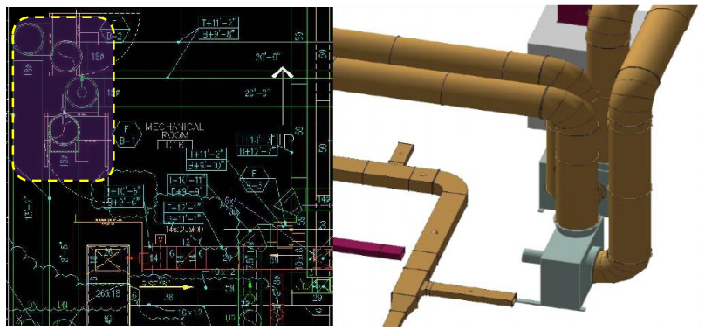
Building Information Modeling
3D Visualization
2D: Separated, Manual → Error prone, Time-consuming
3D: Integrated, Digital → Effective Communication
vs

Slide 14
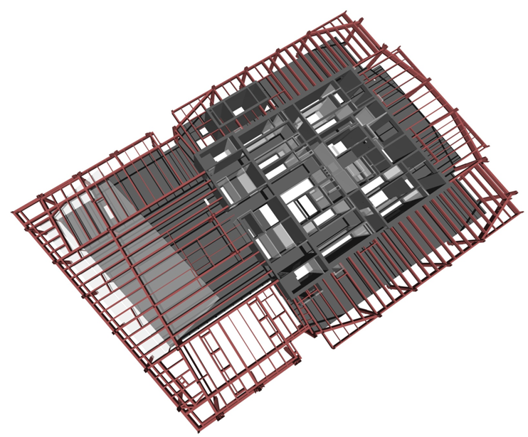
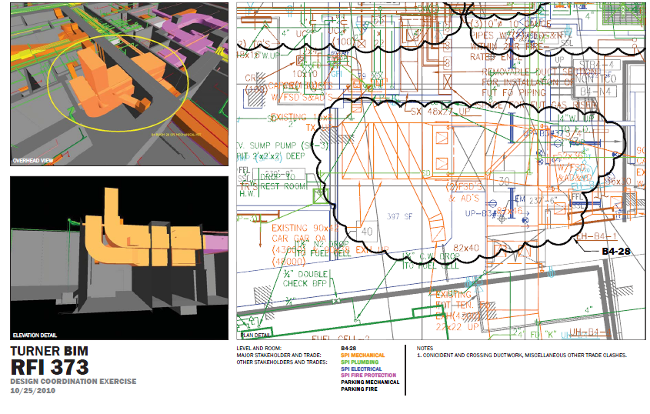

Building Information Modeling
3D Visualization
Model-based Design Coordination Process
Model Creation
Model Management
Communication
Owner
Facility Manager
Architect
MEP
Contractor
Construction Manager
Subcontractor
Engineer
Create and submit model (BIM authoring tools)
Analyze the model and identify issues. (BIM analysis tools)
Create coordination documents
Add issue related information on model or coordiantion document
Check information of issues (in both model and document)
Create coordination documents
Add issue related information on model or coordiantion document

Slide 15
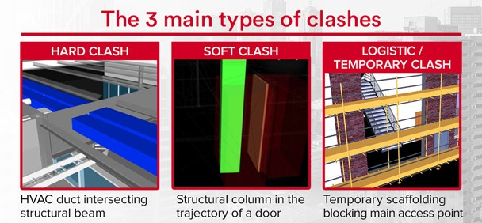
Building Information Modeling
Clash Check
Clash is an unintentional overlap between different objects or too close together so that construction is impossible in that state.
Image Source: https://bimtrack.co/blog/blog-posts/clash-detection-vs-quality-control-the-differences

Slide 16
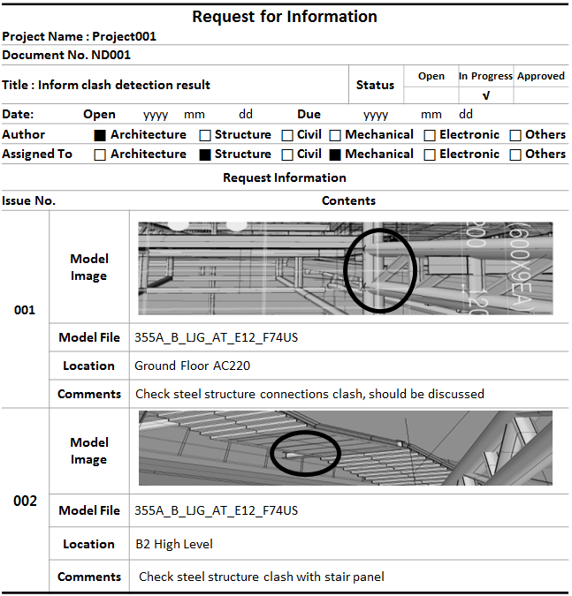
Building Information Modeling
Clash Check
Hard Clash
Two or more objects exist in the same space.

Slide 17
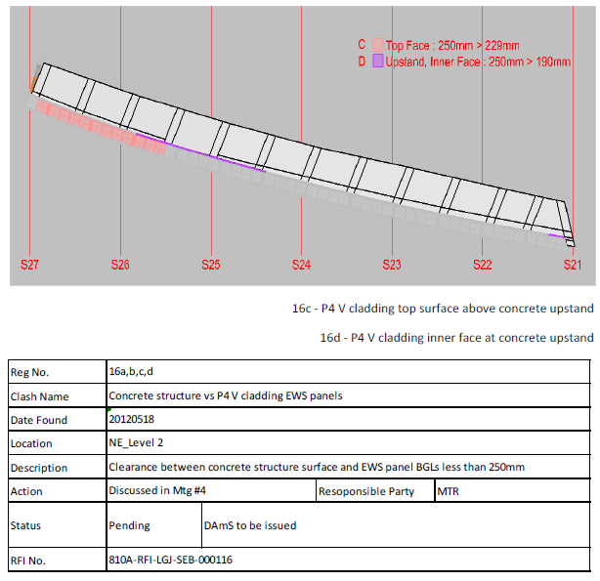
Building Information Modeling
Clash Check
Soft Clash
Two or more objects do not directly overlap, but require the same space.
Insufficient space between objects causes difficulties in construction or use of buildings on site..

Slide 18
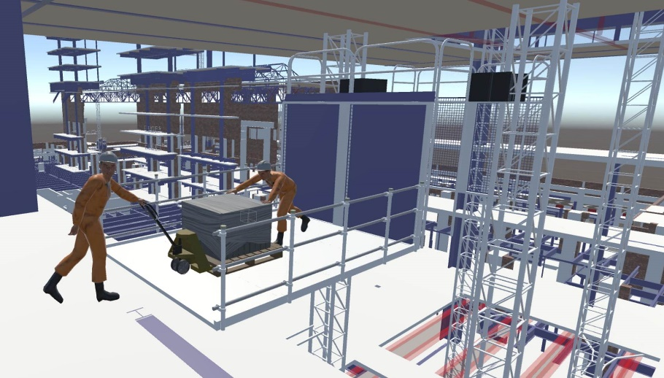
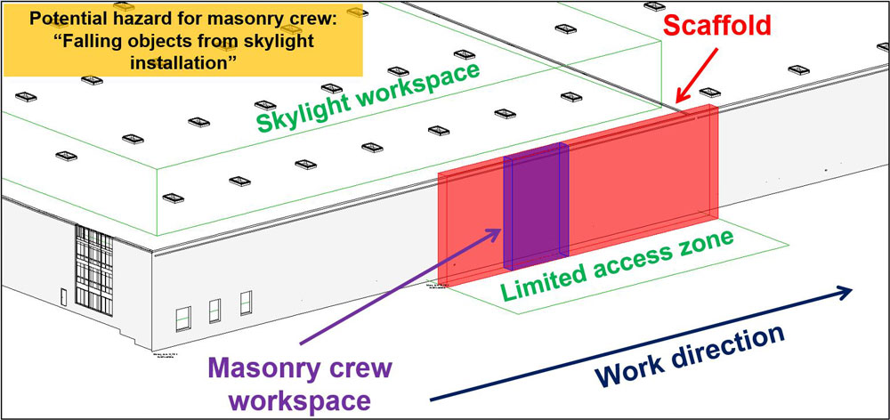
Building Information Modeling
Clash Check
4D / Workflow Clash
Depending on the progress or on-site situation, collisions of objects and duplication of required space occur.
The movement of temporary works and materials during construction is the main cause of workflow clash.
Image Source: Swallow, Mark Richard, and Sam Zulu. "Benefits and Barriers to the Adoption of 4D Modelling for Site Health and Safety Management." Frontiers in Built Environment 4 (2018): 86.

Slide 19
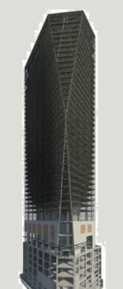
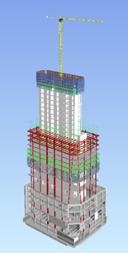
Building Information Modeling
4D Simulation
4D = 3D + Time (referred to as 4D by adding the concept of time to the 3D model).
Model the building shape or site situation during construction, which changes every moment.
Revit Architecture – Modeling
Navisworks – 4D Sequencing

Slide 20
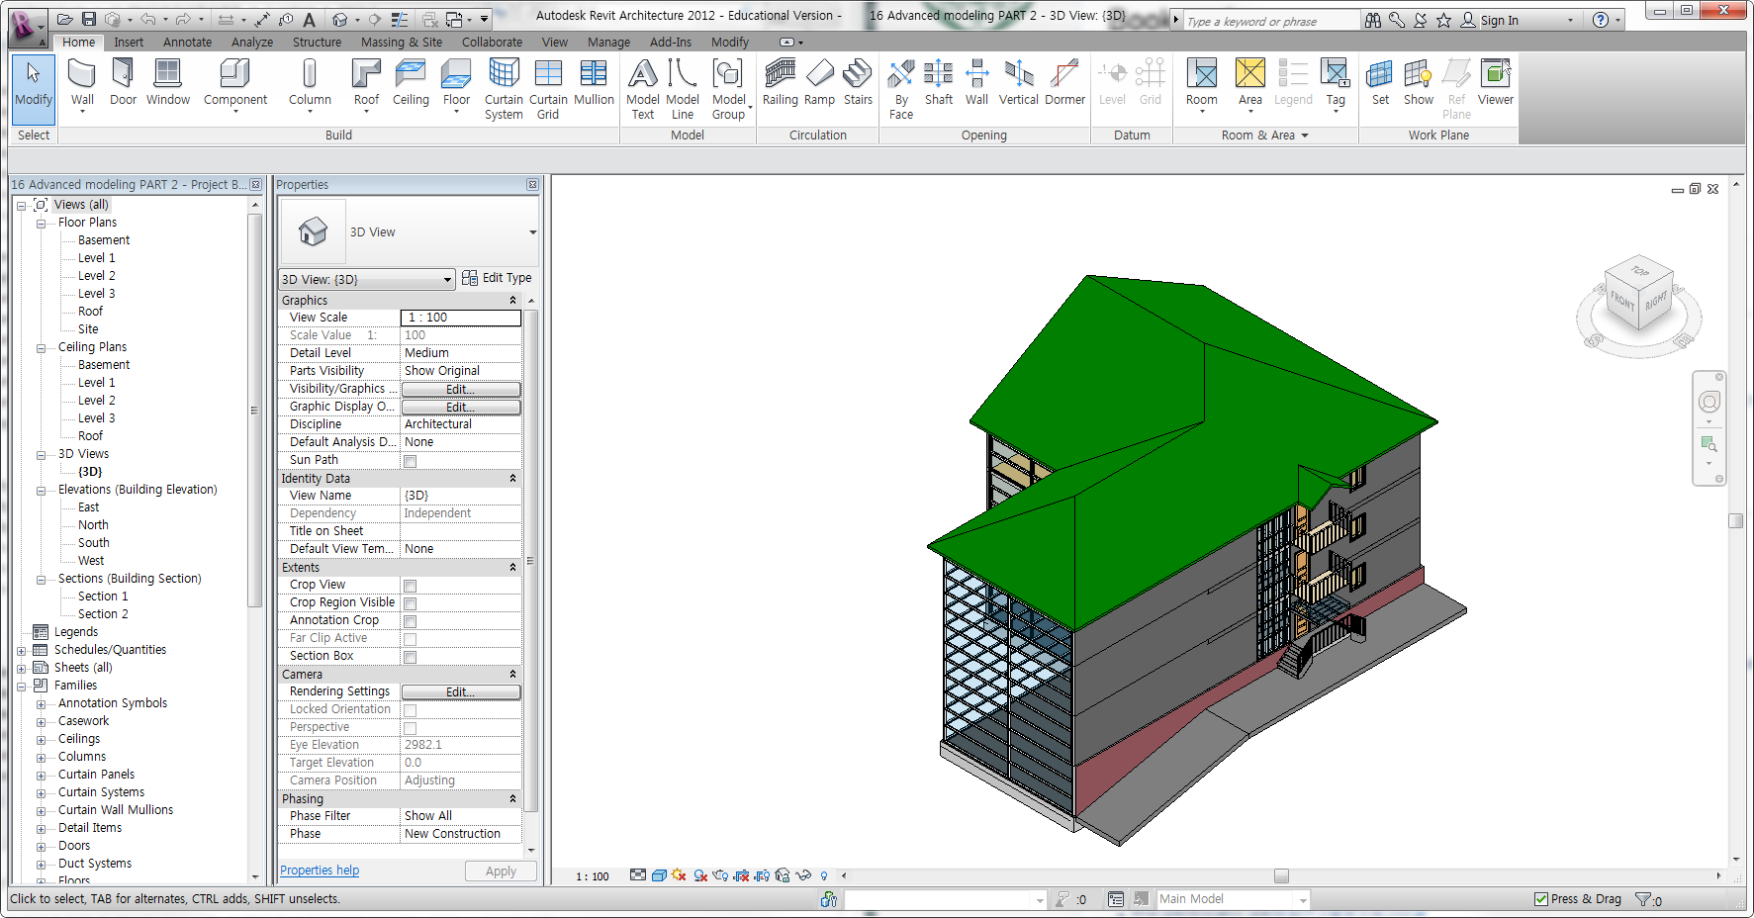
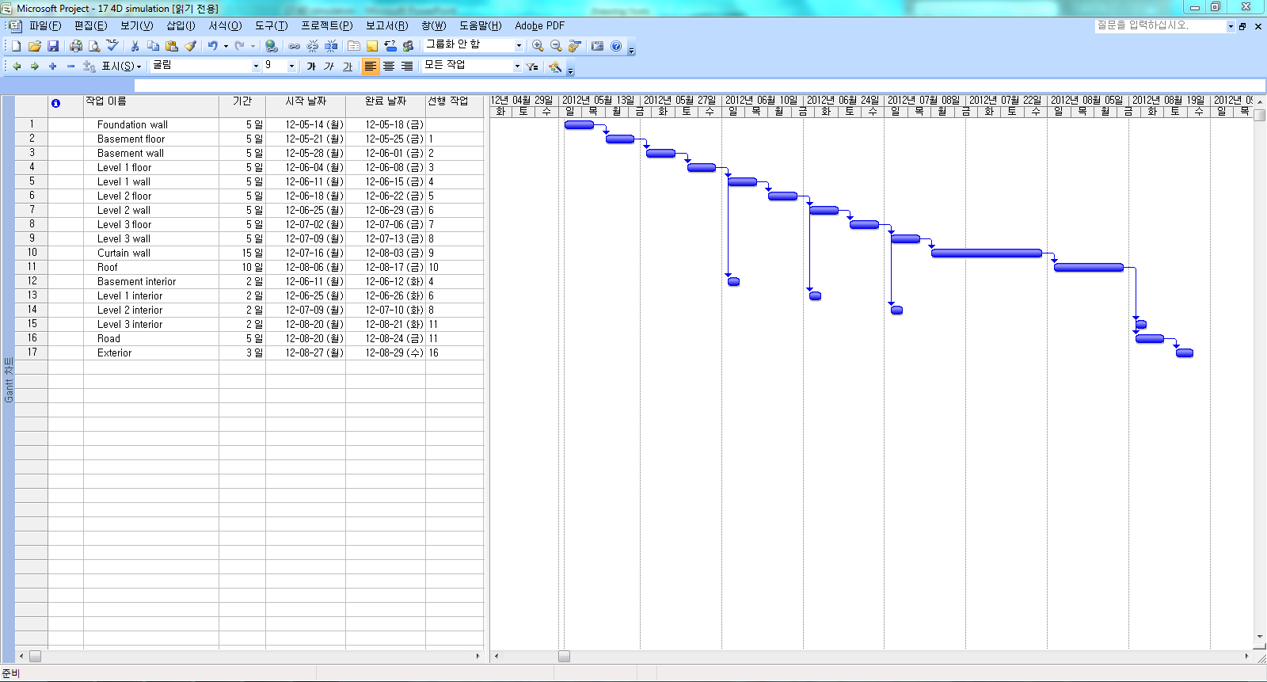
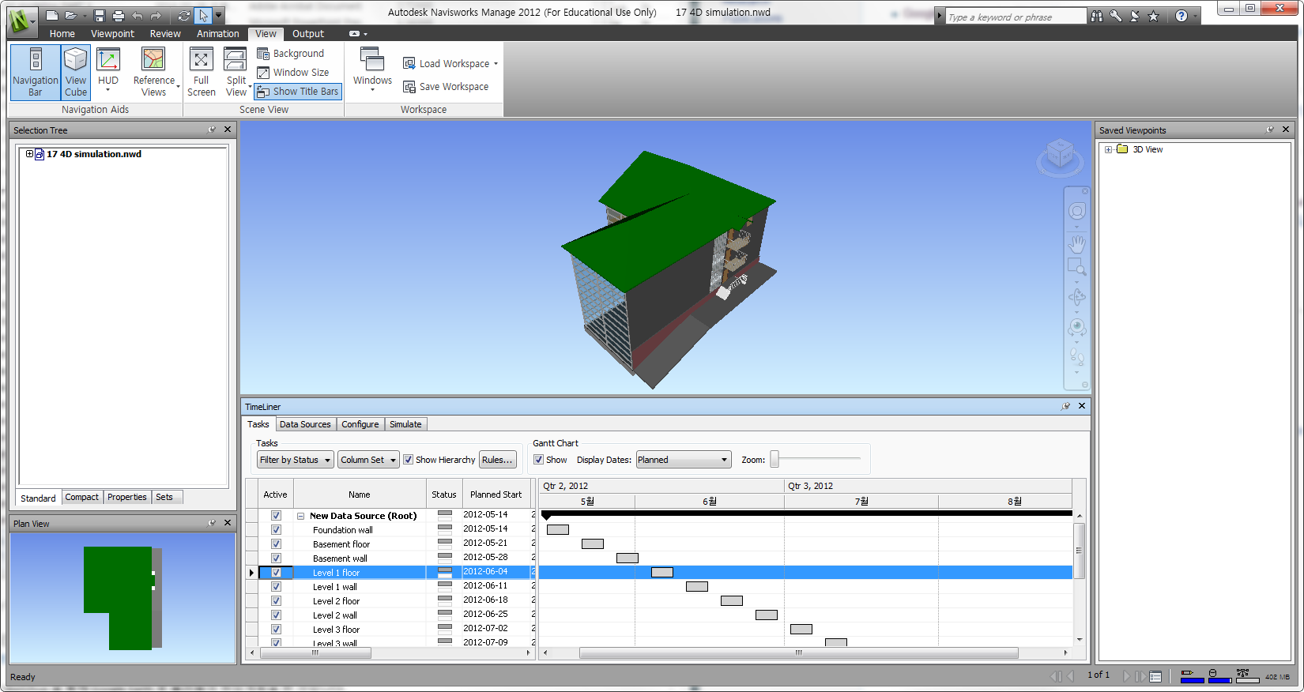
Building Information Modeling
4D Simulation
Import the activity created in the project management software (Primavera, MS Project)
Link BIM objects related to each activity.
<3D Model (Revit)>
<Project Schedule (e.g., MS Project)>
Navisworks Exporter
Import a schedule file
Create a schedule in Navisworks

Slide 21
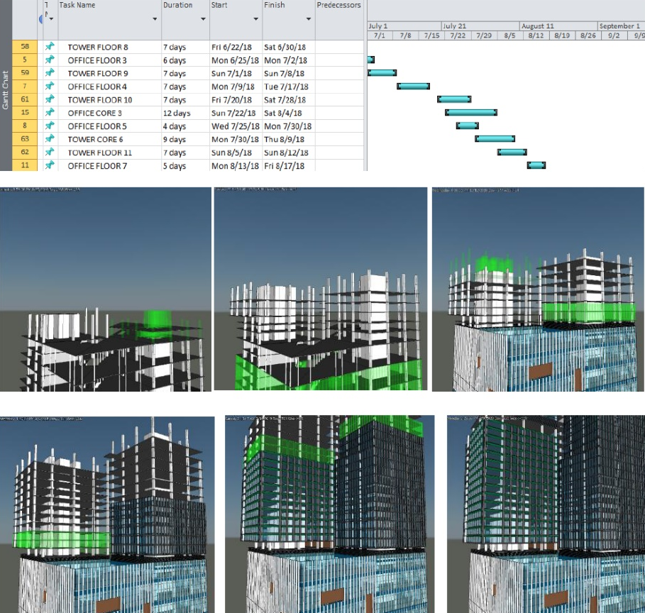
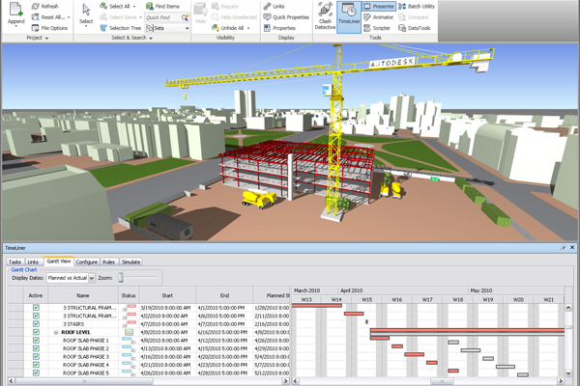
Building Information Modeling
4D Simulation
Checking the actual construction plan in three-dimensional
Analyze the feasibility of the process plan or the retrieval plan in the virtual site.
Navisworks – 4D Sequencing
Image Source: Autodesk University

Slide 22
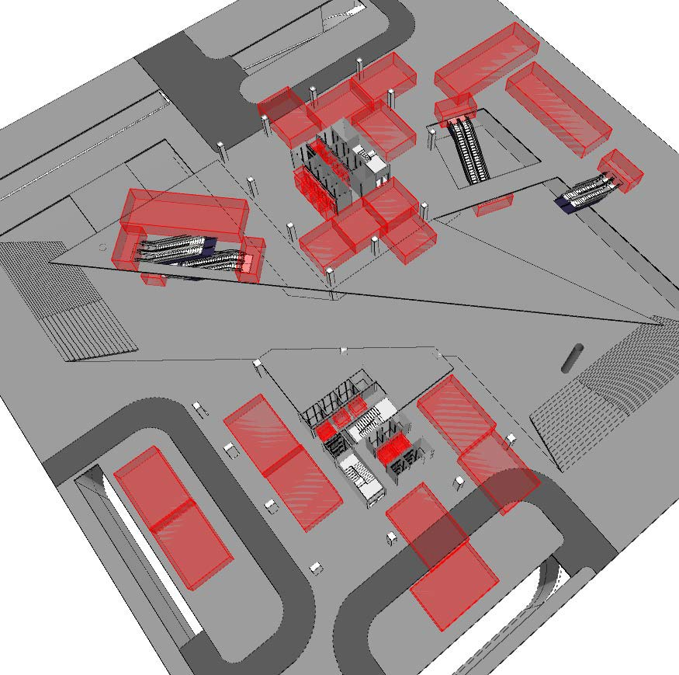
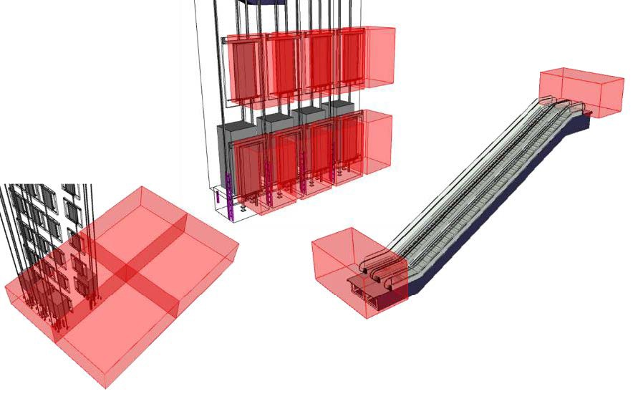
Building Information Modeling
4D Simulation
Help on-site management and safety management by enabling many project participants in the field to consistently understand the situation at the site.
The work space according to the construction sequence is checked in 3D, and information about the process by specialized company such as interior/exterior, equipment, etc. is reviewed with the person concerned to facilitate consultation.
Image Source: Autodesk University

Slide 23
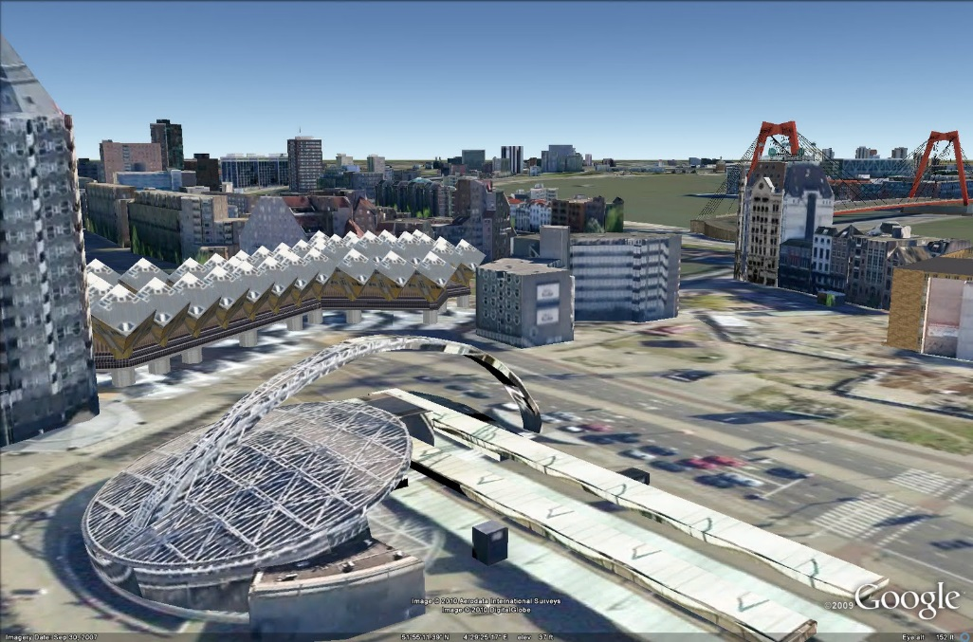
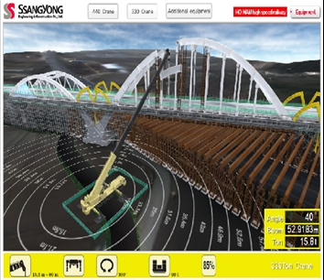
Building Information Modeling
4D Simulation
Review whether it is possible to bring in or store heavy and long equipments or materials at the site.
Various factors can be taken into account, such as materials, equipment, and surrounding traffic conditions.
Revit Architecture/Sketchup/Google Earth – Site Coordination
Modeling the swing of a crane or the lifting of a steel frame, so that the flow of construction can be reviewed from various angles

Slide 24
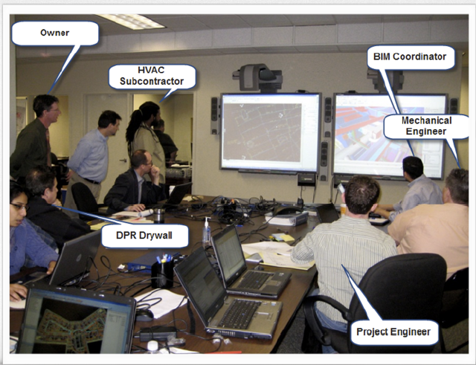
Building Information Modeling
Pre-construction Meeting
(1) Submit individual models of architecture, structure, machinery, equipment, etc.
Individual companies are also required to have 3D BIM modeling skills to participate BIM project.
(2) Integral analysis of 3D models of individual specialist companies.
Using software such as Navisworks.
(3) Communicate with the discovered issues and adjust the design (model).
It is effectively used to find problems between members of different types of construction by specialized companies throughout the design stage, pre-construction stage, and construction stage.

Slide 25
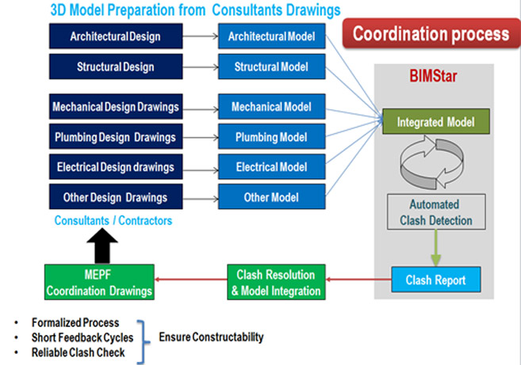
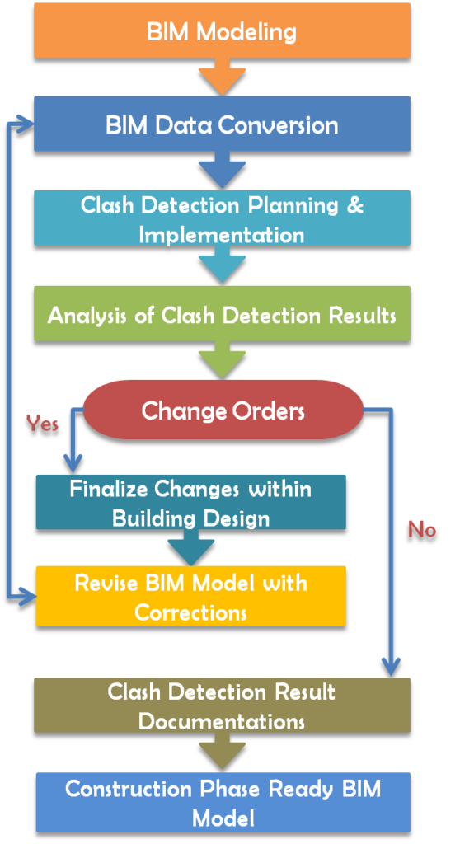
Building Information Modeling
Pre-construction Meeting
Iterative collaboration process
Image Source: (1) http://bimstar.co.in/clash-detection-clash-reports/ (2) http://www.revitmodelingindia.com/services/bim-clash-detection-services/

Slide 26
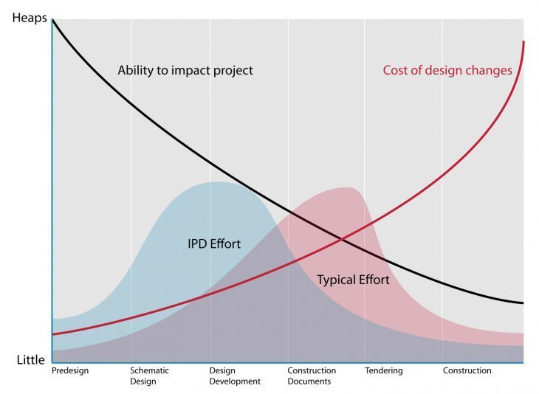
Building Information Modeling
Pre-construction Meeting
Preliminary identification of on-site issues in the design stage and pre-construction stage → Reduction of rework → Shorten construction period, save construction cost
BIM Effort
Image Source: MacLeamy curve (2004)

Slide 27
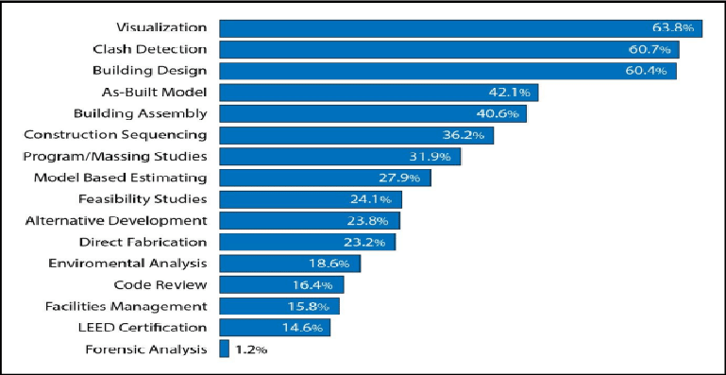
Building Information Modeling
BIM Applications
One of the biggest benefits contractors can get from using BIM
Great improvement in resolving clash, understanding construction details, identifying drawing errors.
Image Source: B. Becerik-Gerber and S. Rice, The perceived value of building information modeling in the US building industry, J. of Information Technology in Construction, 15, 185-201, (2010)

Slide 28
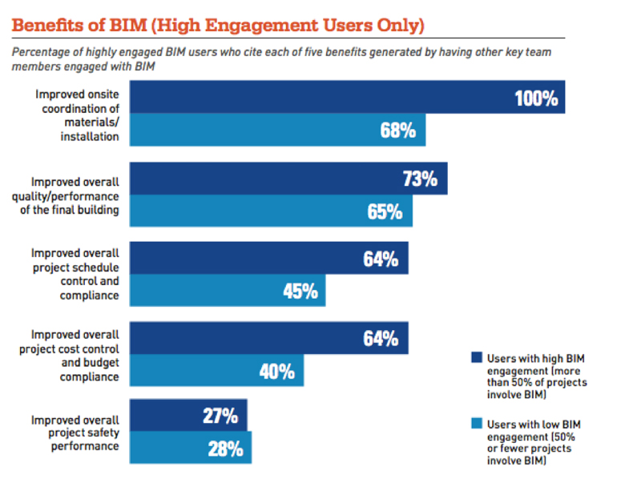
Building Information Modeling
BIM Applications
One hundred percent of MEP contractors and 90 percent of general contractors and structural engineers surveyed report participating in such integrated workflows — with tangible benefits to show for it.
Image Source: https://projectdelivery.autodesk.com/blog/aec-industry-trends-bim-dodge-analytics/

Slide 29
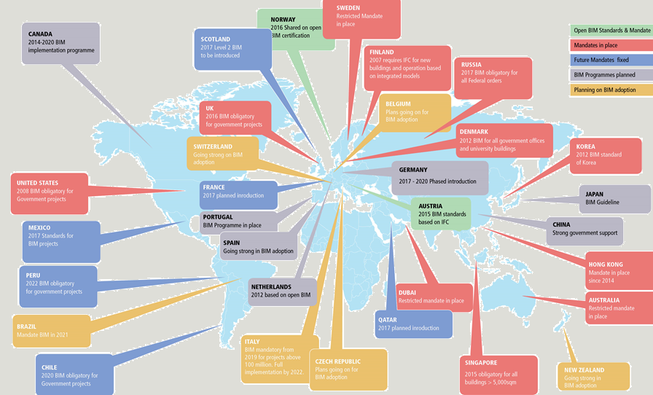
Building Information Modeling
BIM Applications
Starting with the US and Europe, national institutions and companies are actively promoting BIM introduction policies including guidelines and information standards.
Image Source: https://www.geospatialworld.net/article/bim-adoption-around-the-world-how-good-are-we/

Slide 30





Building Information Modeling
BIM Applications
In South Korea, the Ministry of Land, Infrastructure and Transport continues to promote BIM activation policies in all fields of construction, civil engineering, and engineering and to prepare BIM mandatory plan and order for pilot project
BIM도입 활성화를 위한 국가정책
장단기 계획 (2009) : 10 년간 추진계획
제 6 차 건설기술진흥기본계획 (2017) :
스마트 건설구현위한 BIM 핵심기술 적용
세움터 고도화 기본계획 (2009) :
인허가 지능형 서비스에 BIM 도입
제 5 차 건설사업정보화진흥계획 (2017) :
인프라 BIM 활성화 및 플랫폼 개발
국토교통부 (2015) : 2020년까지 사회기반시설 (SOC) 공사 20% BIM 적용
국토교통부 (2017) : 2020년까지 500억 이상 공사 대상 BIM 발주 의무화
2016 년 : 시설사업 BIM 적용지침서 v 1.31 발표
2016 년부터 시설사업 전체 대상 BIM 발주 (50건, 2조 규모)
2017 년부터 입찰 시 BIM 도면 및 보고서 의무화
2011 년 : BIM 가이드라인 발표
2017 년 : Civil – BIM 도입 착수
2009 년 : 공동 주택 최초 BIM 현상 설계 도입
양주 회천지구
파주 운정지구
2013 년 : BIM 마스터플랜 발표
2017 년부터 전사적 체계 구축
시법사업 수행
낙동강 살리기 4개공구
영주댐, 보현산댐
대산임해산업지역 공업용수도
2014 년 : BIM 마스터플랜 발표
2015 년 : BIM 가이드라인 v 1.0
시법사업 수행
부산외곽순환 고속도로
대구순환 고속도로
함양울산간 고솔도로
Image Source: the Korea Institute of Civil Engineering and Building Technology

Slide 31
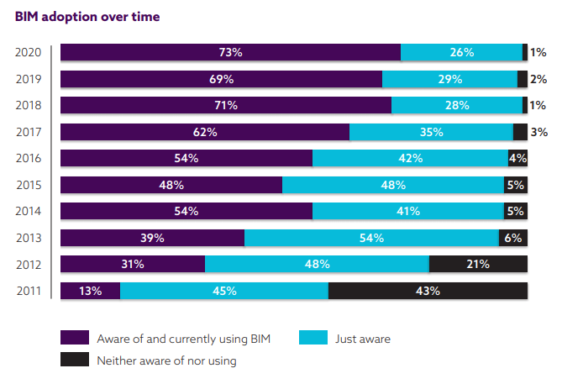
Building Information Modeling
BIM Applications
2010: 43% don't know BIM
2020: 73% use BIM
Image Source: https://www.thenbs.com/knowledge/national-bim-report-2020

Slide 32
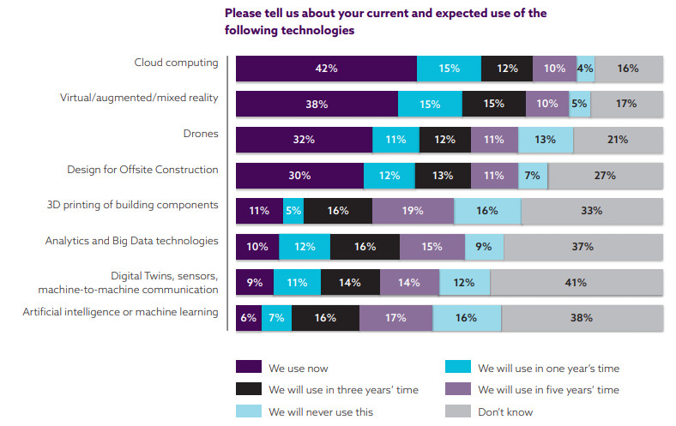
Building Information Modeling
Future of BIM
4th Industrial Revolution
Image Source: https://www.thenbs.com/knowledge/national-bim-report-2020

Slide 33

Smart Construction
4th Industrial Revolution
The next-generation industrial revolution brought about by the convergence of information and communication technology (ICT).
New technological innovations in areas such as big data analytics, artificial intelligence, robotics, Internet of Things, unmanned vehicles (drones, unmanned vehicles), 3D printing, and AR/VR technologies.
Image Source: http://news.unist.ac.kr/kor/column_202/

Slide 34
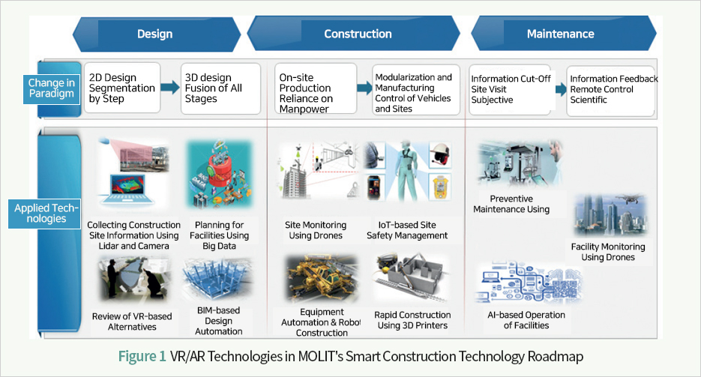
Smart Construction
Smart Construction
Various technologies to innovate productivity based on information sharing and connectivity of all participants in all stages of construction work, such as planning, design, construction, maintenance, and demolition, using the 4th industrial revolution element technology
Image Source: Ministry of Land, Infrastructure and Transport

Slide 35
Smart Construction
Smart Construction
Experience-dependent industry → Paradigm shift to knowledge and high-tech industry
Overcoming the limitations of manpower → Improving productivity and safety
Image Source: Ministry of Land, Infrastructure and Transport

Slide 36
Smart Construction
Smart Construction
Experience-dependent industry → Paradigm shift to knowledge and high-tech industry
Overcoming the limitations of manpower → Improving productivity and safety
As-is | To-be
Data-oriented Decision Making
Separated information | Information sharing and distribution
Experience-dependent | Optimization through data analysis
Repetition of trial and error | Prediction through simulation
Technology Convergence
Separated individual | Activation of technology application
Segmentation by stages | Integration of all stages of construction
Manual and repetitive work | Communication and collaboration
Consumer-oriented technology
Skilled labor | Automate workforce
2D | 3D + α
Supplier-centric | Consumer participation
Source: Ministry of Land, Infrastructure and Transport

Slide 37
Smart Construction
Smart Construction
Application technologies: big data analytics, artificial intelligence, robotics, Internet of Things, unmanned vehicles (drones, unmanned vehicles), 3D printing, and AR/VR technologies.
Category | Technologies for Smart Construction
Platform | BIM, Cloud
Data collection | IoT, Sensor, Drone (UAV), Robotics
Data analysis | Big Data Analytics, Artificial Intelligence
Automatic Manufacture | Modular construction, 3D Printing
Applications | Virtual Reality, Augmented Reality

Slide 38
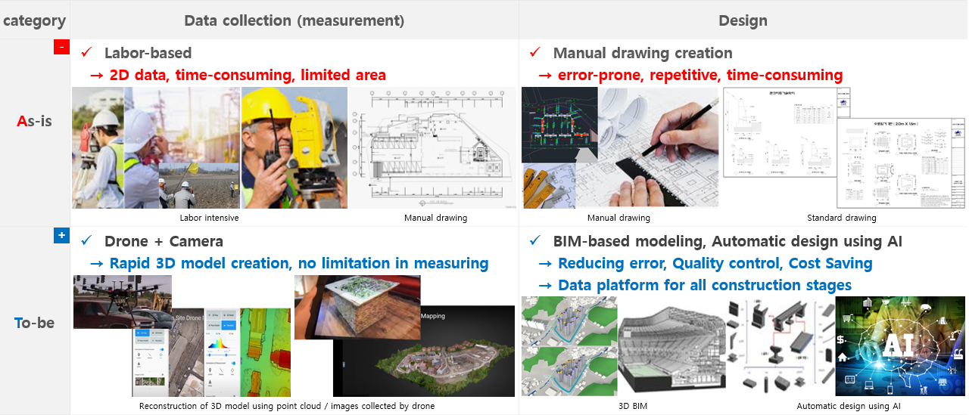
Smart Construction
Smart Construction
Design stages
Source: Ministry of Land, Infrastructure and Transport

Slide 39
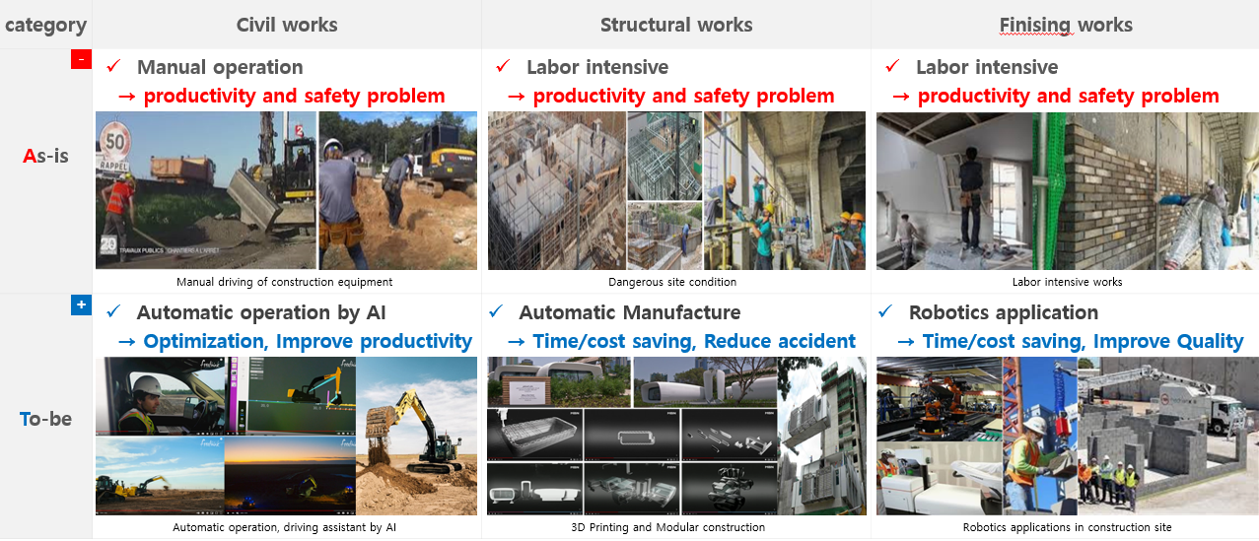
Smart Construction
Smart Construction
Construction stages
Finishing
Source: Ministry of Land, Infrastructure and Transport

Slide 40
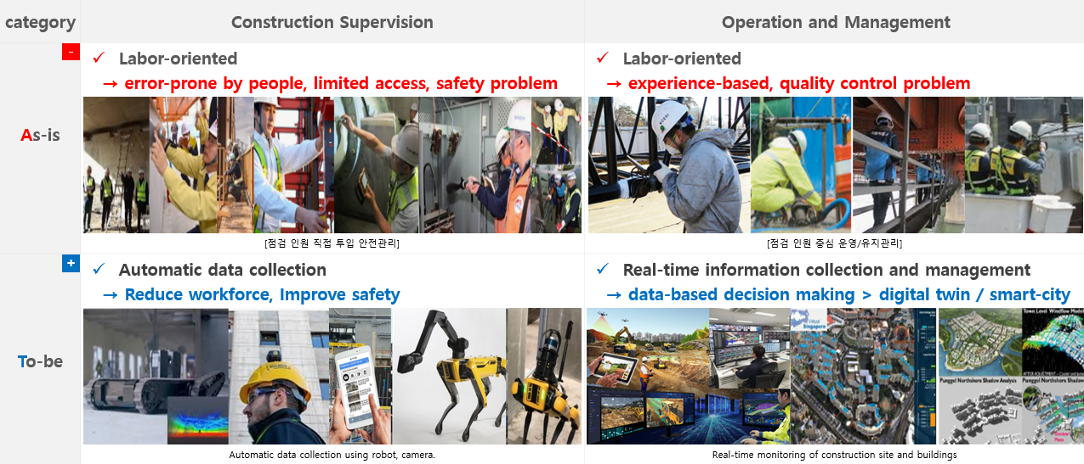
Smart Construction
Smart Construction
Operation and management stages
Source: Ministry of Land, Infrastructure and Transport

Slide 41
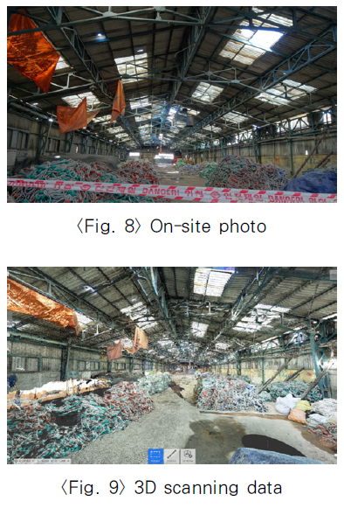
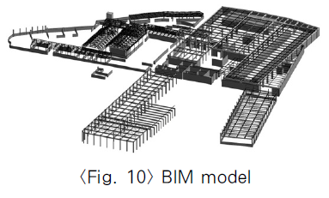
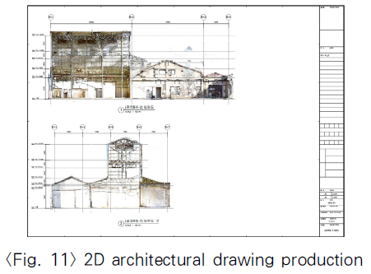
BIM & Smart Construction
BIM & Smart Construction
Reverse engineering : Obtain design / engineering information of the building through 3D scanning or sensor and use it for project management (construction, maintenance).
Source: Utilization of 3D scanner and BIM for uprising 4th industrial revolution

Slide 42
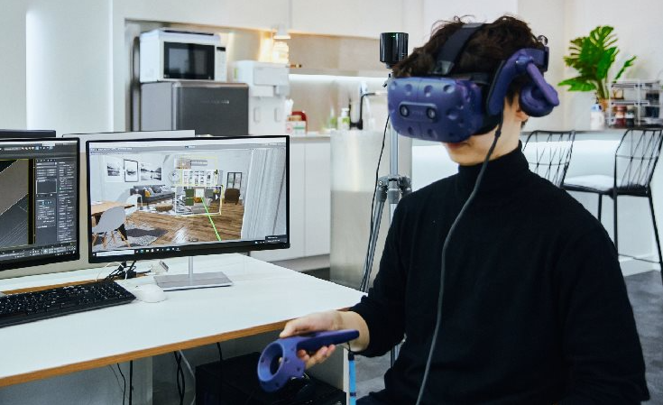
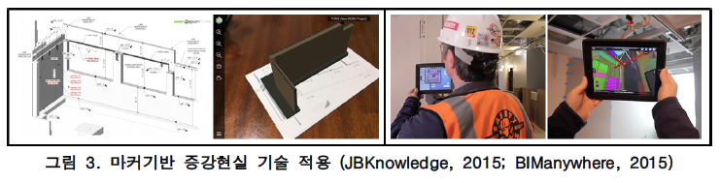

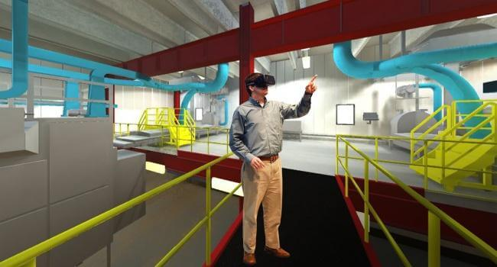
BIM & Smart Construction
BIM & Smart Construction
Virtual Reality / Augmented Reality: A number of studies have been conducted examining the utility of immersive VR/AR for promoting architectural design collaboration, project site management, worker safety education in a more immersive environment by implementing BIM project information in a virtual space.
Image Source: JBKnowledge (2015), BIManywhere (2015)

Slide 43
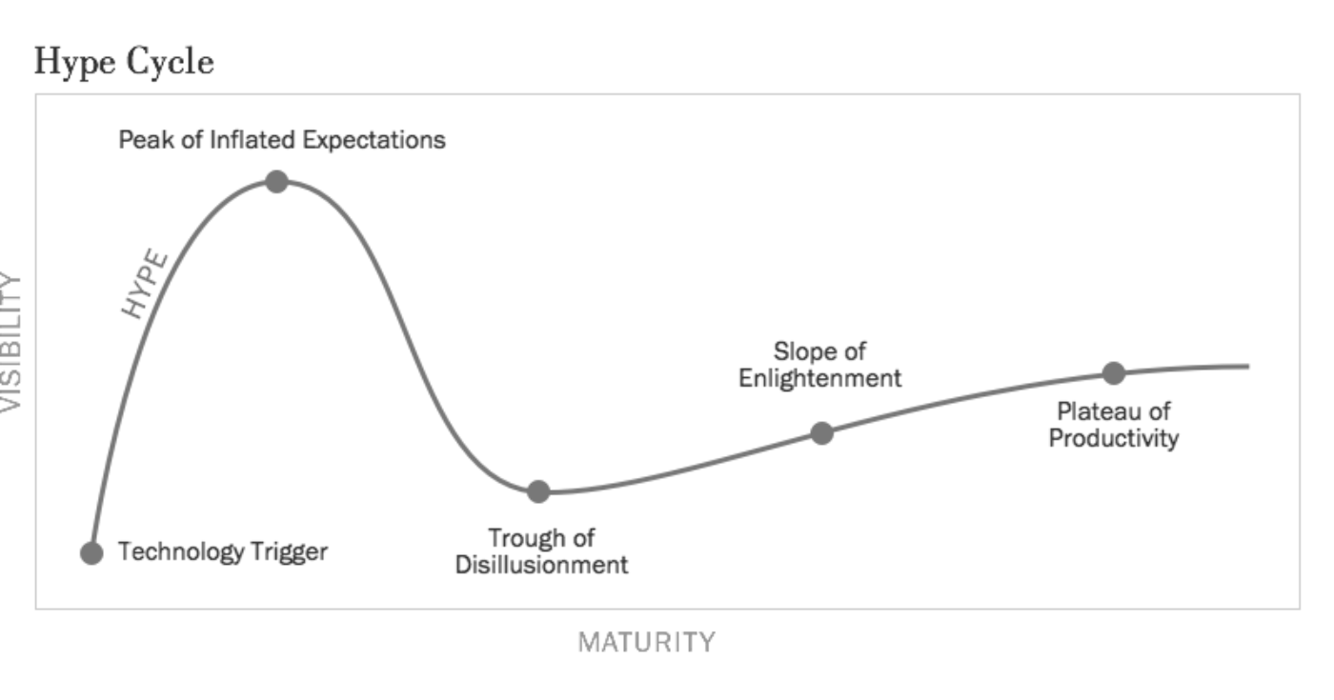
BIM & Smart Construction
BIM & Smart Construction
More than 20 years have passed since BIM was applied in the construction field.
As successful cases of BIM project are shared, the need to apply BIM and the will to adopt it arises.
At the same time, skepticism about BIM arose as several failure cases were accumulated.
It is judged to be a stage of re-lighting in Gartner's Hype-cycle.
BIM do all
BIM skepticism
BIM again ?
Integrated project management
Productivity improvement
Project success
Initial investment
Added work process
Apply BIM for showing
Digital project management
Industry competitiveness
Platform for smart construction
Image Source: Hype-cycle (Gartner)

Slide 44
BIM & Smart Construction
Summary
Problem Identification at the Early Stages of Construction
Technologies for Tracking the Construction Process
Low Productivity
Low Digitalization
Labor Intensive
Post-Corona
Safety
Time
BIM & Smart Construction
Cost
Quality

